Slide 1
ICT SPECIALIZATION
MODULE 1 – LESSON 1
Introduction to Programming

Slide 2
HOW WILL YOU ABLE TO SELL THIS PRODUCT?

Slide 3
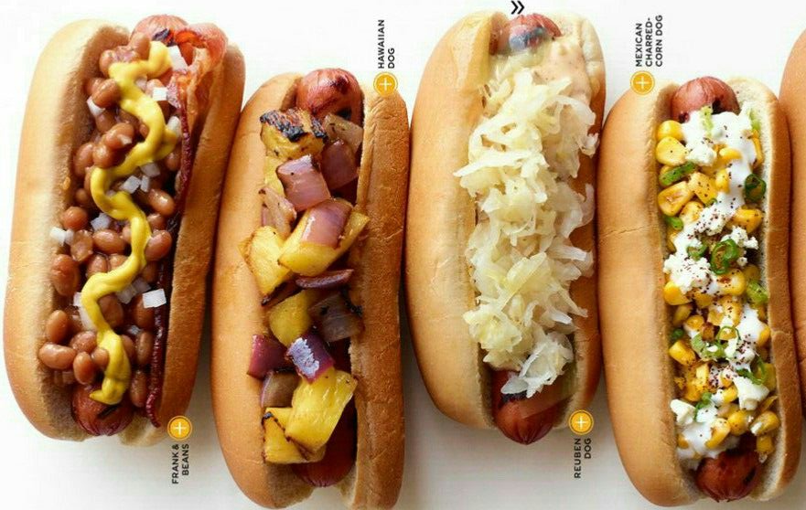
GOURMET HOTDOGS

Slide 4
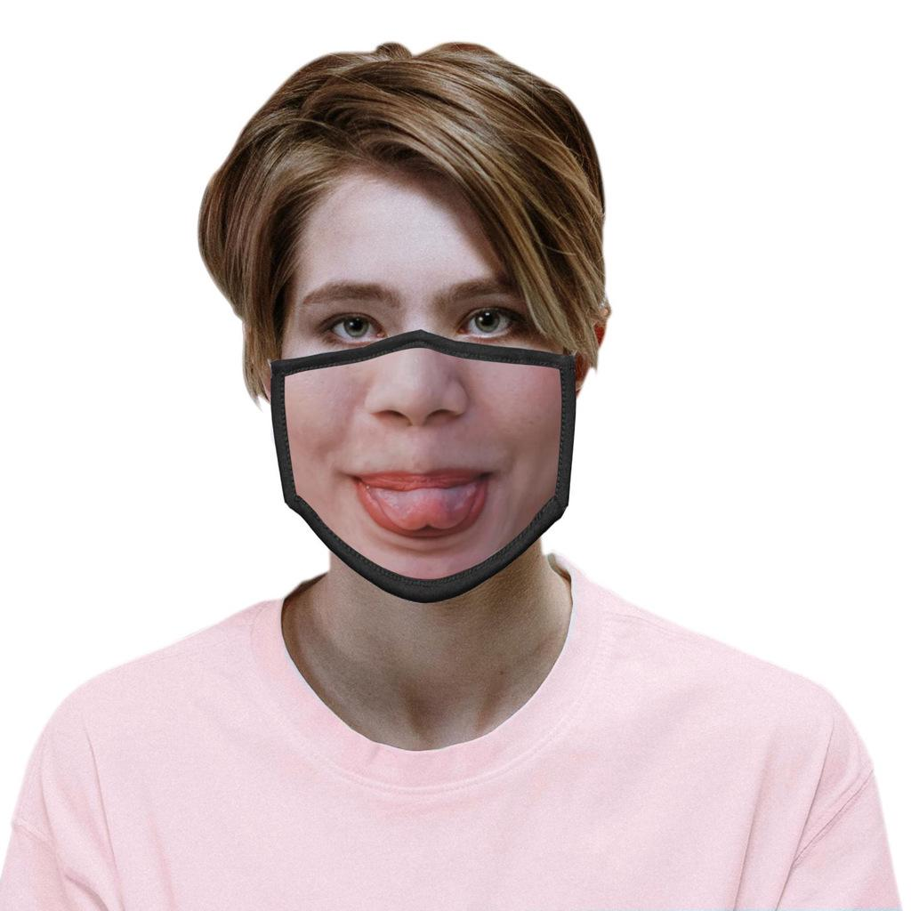
FUNNY FACE MASK

Slide 5
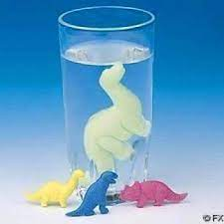
WATER GROWING TOYS

Slide 6

DANCING CACTUS PLUSH TOY

Slide 7
1.1. Personal Entrepreneurial Competencies (PECs)
Characteristics of Successful Entrepreneur

Slide 8

HARDWORKING
It actually means that he must do
what he must to be able to cover all the aspects relating to his line of business—
production, marketing, purchasing raw materials, prospecting and relating to
investors, among others.
He must be a "jack of all trades," following every lead and opportunity that comes his way to improve his product (or service) especially during the start-up stage.

Slide 9

SELF-CONFIDENT
It means that to bean entrepreneur, you should have a very strong belief in yourself that you can face and overcome challenges that comes your way. You must have a "can do-attitude that allows you to have a very positive Outlook, which is very important to an entrepreneur.
This characteristic is essential because it is the driving force to be able to overcome uncertainties while creating and growing the business.

Slide 10

FUTURE-ORIENTED
You should always look ahead and try to discern and find ways to make sure that your business stays in operation.
Being future-oriented also means that you look ahead and see yourself at future how you and your family will live, remember that you cannot work forever. So, an entrepreneur. you must also learn and practice how to save up and secure your family future.

Slide 11

PROFIT-ORIENTED
Profit is a financial gain you get in creating and maintaining your business, this is one of
your drivers to continue your business.
If you put too much profit on what you are
selling, there might not be any sale at all because no one or very few can afford it.

Slide 12
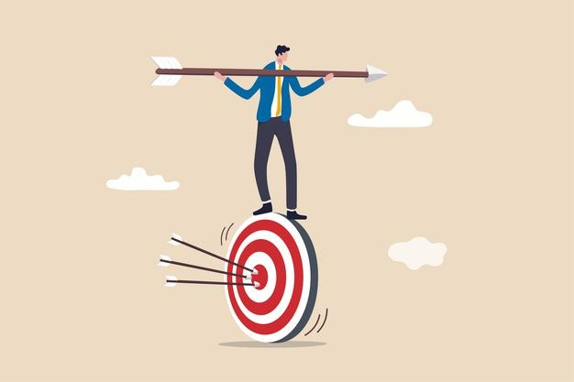
GOAL-ORIENTED
Goal is the general direction where or how far you want take your business. while the objectives are the desired results for each step you take in moving your business to get to your goal
Whether that goal is as plain as getting profit or as profound as to be ab le to provide employment for others, that goal is the driving force for the entrepreneur to keep building his business.

Slide 13
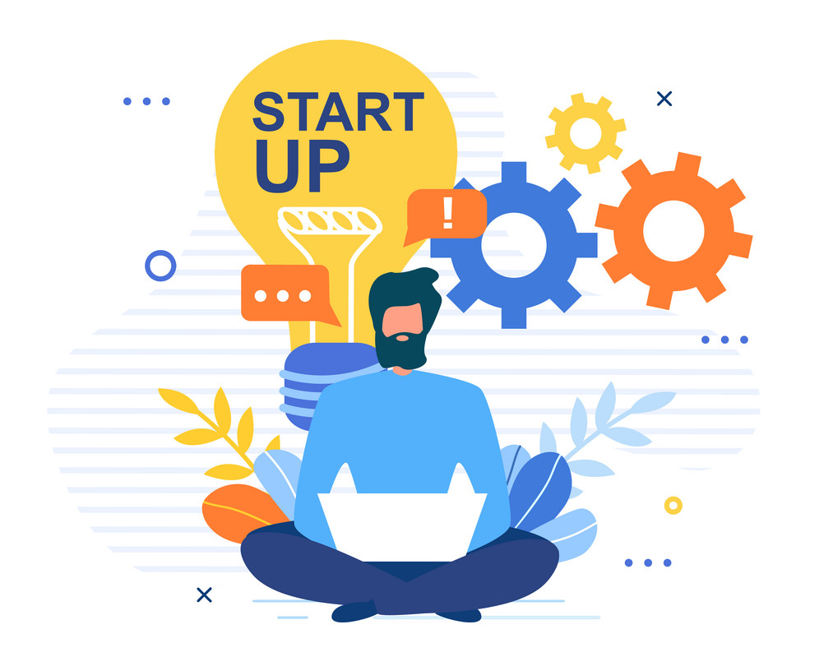
PERSISTENT
Persistence is the strong will of a person and a firm belief to keep on moving forward to achieve his goal no matter how many challenges may come his way or no matter many times he fell along the way.
It is when you are faced with negative opinions about what you are doing that your persistence is tested.

Slide 14

OTHER PERSONAL ENTREPRENUERIAL COMPETENCIES (PECS)
Ability to Cope with Failure
Open to Criticism and Acknowledges Feedback
Takes the Initiative
Sets Own Standards
Copes with Uncertainty
Committed
Ability to Build on Strength
Willing to Listen
Freedom and Control
Flexibility
Energy and Stamina
Family Support
Professional Support

Slide 15

1.2 Product Development

Slide 16
Product development, also called New Product Development (NPD), refers to
the creation of a marketable product or service that provides additional benefits or
satisfies the needs of a customer or consumer. It either involves the creation of a
totally new product that satisfies a need or a modification of an existing product to
make it better.

Slide 17
New Product Development Process
Idea Generation - The initial step of the process is the idea generation stage that entails some creative thinking exercise. Like any good product, it starts with a spark of an idea. However, it did not necessarily start with just a single spark. It may have just started with one question: "What if. one question would have sparked a host of idea that slowly builds up the product as a whole.
Idea Screening- This step of the process requires some analytical exercise. Not all ideas that were gathered from the first step can be used to create a complete product. Some ideas have to be weeded out based on certain criteria. This is not to say that the weeded-out ideas are bad.
Pass-fail evaluation- This may well be the simplest evaluation process that you can do but it
relies heavily on a well-thought set of criteria, just like the rest of the methods, which determines whether the idea makes it to the next round or not. Usually the criteria used in this method conform with the three main anchors of a good business idea:

Slide 18
Pass-fail evaluation
i. Value to customer— Does the business idea significantly add or give
satiation to your customers?
ii. Solve a significant problem or satisfy a significant want/need — Does it address and bring solution to a problem or need that has to be satisfied?
iii. Make significant profit in the shortest time possible — Will your target
customers recognize all this value and be satisfied with what your business idea
brings and give you profit in the shortest time with the least promotion?

Slide 19
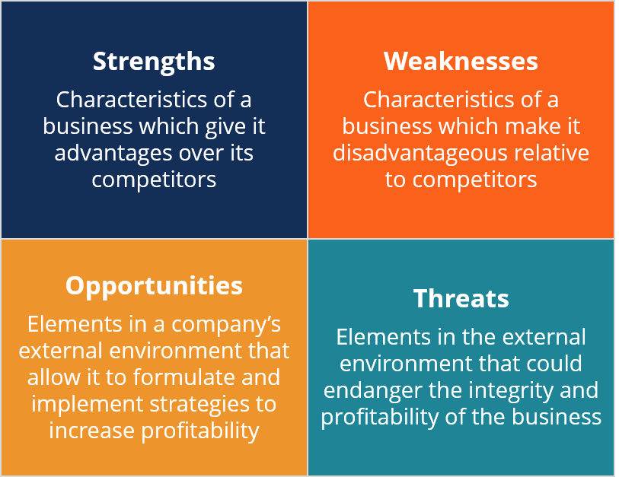
SWOT Analysis — so, it comes down to just a few more ideas, say two to five ideas and the matrix shows a close match among the remaining ideas. For the final round of weeding out, you can use the SWOT analysis tool to single out the best business idea that you may want to pursue. SWOT stands for Strength, Weakness, Opportunity, and Threat. This tool uses a simple quadrant that represents earth of the SWOT.

Slide 20
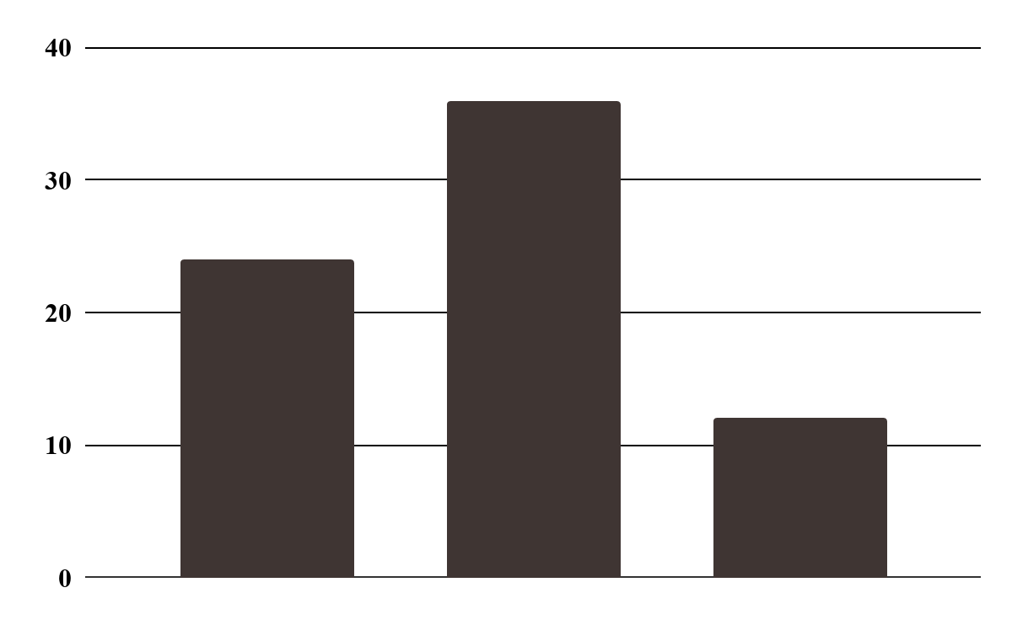
Concept Development and Testing
This is the feasibility
study stage. The purpose of the study is not only to find out whether the product
can be manufactured or created but also if it is marketable. During this step, you
may need to consult and share your idea with some trusted people like colleagues
and other experts.
A
B
C

Slide 21
Business Analysis
The cost of producing the product as well as the cost
of marketing it is weighed against the salability of the product. In other words, this
stage will allow you to find out if you are, in fact, heading for a profitable
proposition so you can decide whether there is a need to make any adjustments to
make the product more profitable. A number of techniques and tools are used
during this stage like the SWOT and the Five Whys.

Slide 22
Prototype Development
A prototype is the first or preliminary model of a certain product. Just like any development process, this stage has a cycle of its own. More often than not, you do not get to create one prototype and get it right the first time. Developing prototypes involve a series of fine tuning from your original-design until you arrive at a complete, safe, functional, rich in feature, and marketable product.
Test Marketing
After an actual product has finally materialized, a marketing strategy must be developed in order to ensure that you will get maximum returns on your investment for the new product. Not just a maximum return but maximum profitability as well. In order to minimize the cost of marketing the product, the marketing strategy has to be tested either in a simulated market or an actual one with a small population of precise targeted customers. Depending on the result of the test marketing stage, after some adjustments or fine-tuning on the marketing strategy selected, the final stage will be initiated.

Slide 23
Commercialization
After coming up with the final product and producing it for commercial consumption, the final stage is launching or rolling the product out in the market in full scale. This may involve setting up a whole new team to take care of marketing, production, and distribution of the product, all of which must be well coordinated. In a sense, the last step of your product development cycle is the start of your operational cycle.

Slide 24
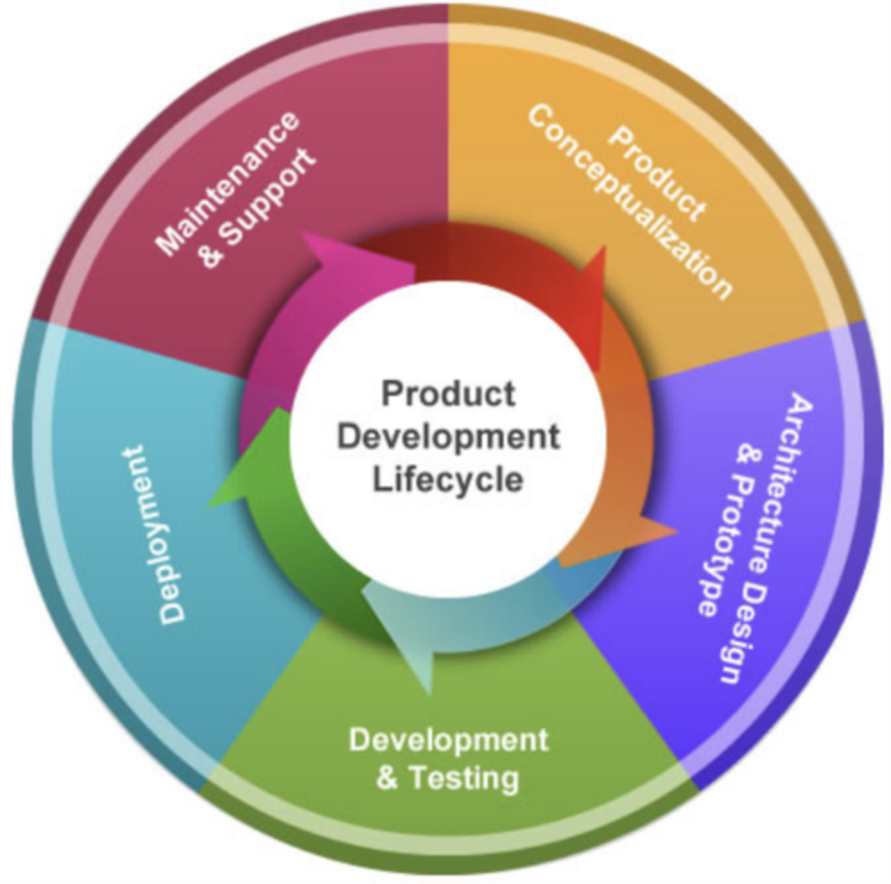
Product Development Life Cycle

Slide 25

BRANDING
Branding is what gives your business an identity. It also creates a first impression to
your customers. More than a logo, your brand shouId reflect all the different aspects
of your business: not only the "whats" but also the "hows."

Slide 26
BRANDING
Your brand is reflected in different things, big or small. It is reflected in your
business name, in the manner you do business, how your staff dress up (uniform),
your office premises, your pricing, and even in your marketing materials and
advertising, but more importantly, 'n the manner or style of your customer service..

Slide 27
Criteria for making a good brand name; Distinctiveness/Uniqueness — the most basic characteristic of a brand name. As much as possible you would to create and establish a brand name that will only denote your business or your product alone. This is why most successful brand names are those that carry or has a "presence" Of a noun in it. Brevity — refers to whether your brand name is short enough to be recalled easily without having to resort to giving it a "nickname" or an abbreviation (like CocaCola or "Coke"). Appropriateness — refers to how well your brand name reflects and identifies your product or business. Is it suited? Does it show any relevance between your product or business and your audience? Easily spelled and pronounced - does your brand name require a certain degree of intelligence before anyone catches it and identify what it refers to? Normally, this leads to effective memory retention or how easy it is to remember your brand name. Appeal/Likability — implies how much impact your brand name gives out so that people, aside from remembering it easily, will always look for it or want it. It is this criterion that helps promote loyalty product or business. Extendibility — refers to how a brand name lends itself to other lines of products to give it its character. brand from SM supermarkets) Protectability - refers to how well you position your brand name to make it original so it can be trademarked. This means that, no matter where your product or business ends up in the world there will be no doubt that the brand name you are carrying is yours and solely refers to your product or business.

Slide 28

Engaging Activity 1:
Animated Infographics!
Topic: What describes a successful entrepreneur?
Use any editing apps/tools to enhance your work.
DUE DATE: FEBRUARY 5, 2025 - WEDNESDAY

Slide 29
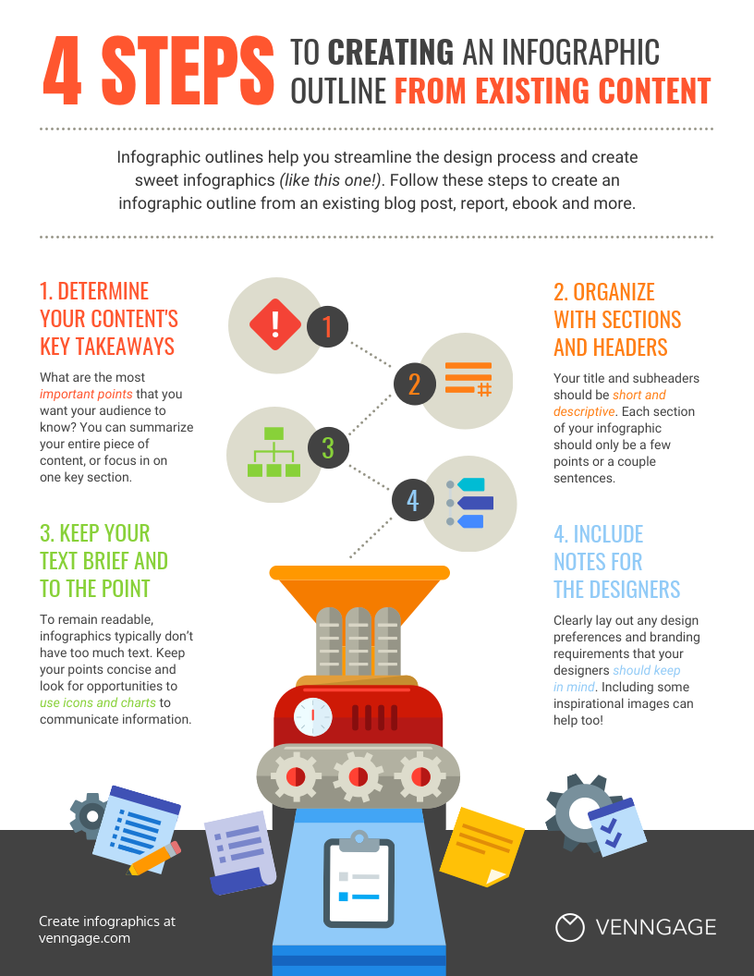
What is an Infographic?
EXAMPLE
An infographic is a collection of imagery, charts, and minimal text that gives an easy-to-understand overview of a topic. As in the example below, infographics use striking, engaging visuals to communicate information quickly and clearly.

Slide 30

Engaging Activity 2:
Engaging Activity 2:
Creating BRAND!
Create a strong brand name that your business and products will
allows your customers to easily remember and assurance that your product
will satisfy their needs, and a brand that they can trust.
DUE DATE: FEBRUARY 5, 2025 - WEDNESDAY

Slide 31
THANK YOU AND GOD BLESS

